Slide 1


Today's agenda
Project recap
Problem
The Analytics team
Process
Insights
Summary

Slide 2


social buzz is a fast growing technology uniciorn
That need to adapt quickly to its global scale
Accenture has begun a 3 month POC focusing on
these task:
An audit of social buzz big data practice
Recommendation for a succesfull IPO
Analysis to find Social buzz top 5 most popular
Categoriesof content
Project Recap

Slide 3

Process
1
Data Understanding
2
Data Cleaning
3
Data modelling
Data Analysis
4
5
Insights

Slide 4

Insights
16
Unique categories
1897
Reactions to “Animal”
JANUARY
MONTH WITH
Most post

Slide 5
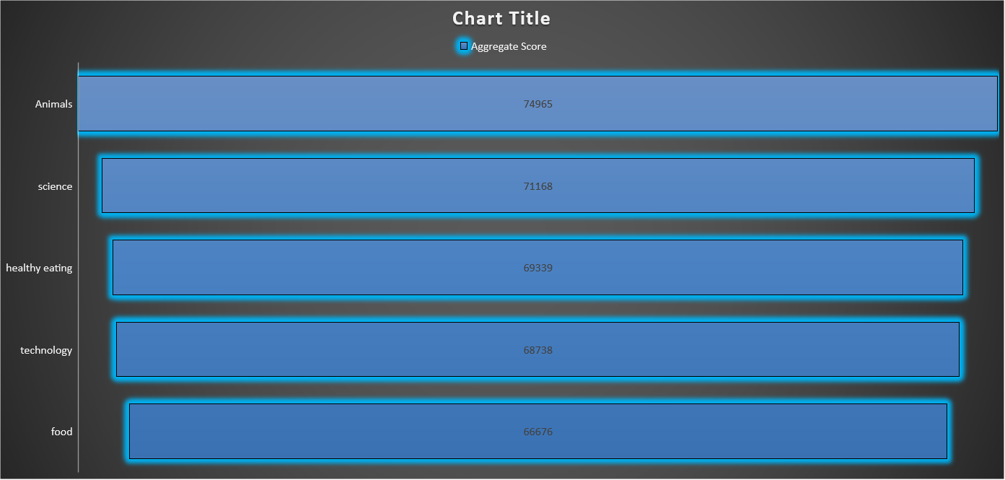

Slide 7

Animal is the most popular categories of content , it show that people enjoying watching animals content
One key insight from our data is that food is a prevalent theme within the top 5 categories, with "Healthy Eating" ranking the highest. This information can be leveraged to target a specific audience within our user base. For instance, we can collaborate with healthy eating brands to launch a campaign that promotes healthy eating habits and improves user engagement. This approach would enable us to tap into the growing interest in wellness and healthy lifestyles among our users and position our platform as a valuable resource for health-conscious individuals.
Summary
NEXT STEP
Lets take this analysis to net level and real time understanding of your business , we will show youhow to do this

Slide 8
Thank you!
ANY QUESTIONS?

